Slide 1

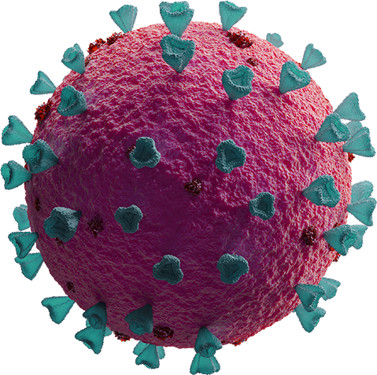
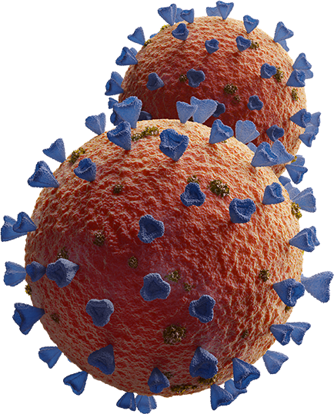
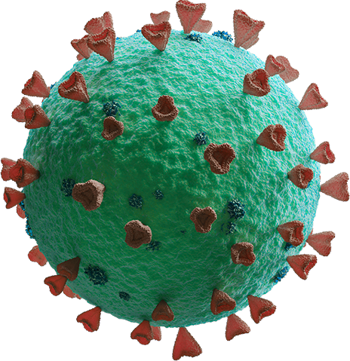
SARS-CoV-2 & Autoimmunity
The current state of vaccine protection provided for the immunosuppressed
The Falk Lab
UNC Kidney Center
Department of Nephrology and Hypertension
School of Medicine

Slide 2
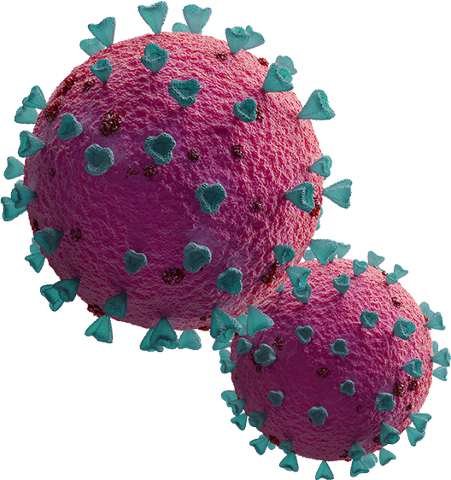
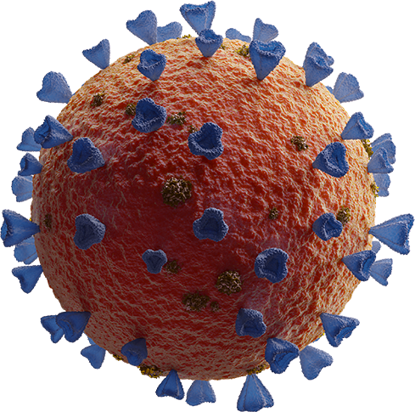
IMMUNOSUPPRESSED
Individuals who possess a medically reduced immune system often to prevent transplant rejection or to suppress autoimmunity

Slide 3
785,543
Immunosuppressed adult individuals accounted for 12.2% of COVID-19 hospitalizations between the years of 2020 and 2022 in the United States while only making up an estimated 3% of the total population

Slide 4
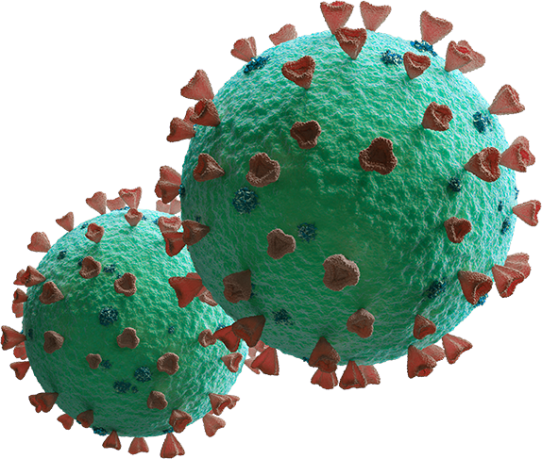
Are vaccinated immunosuppressed individuals equally protected against pathogens as vaccinated healthy individuals?

Slide 5
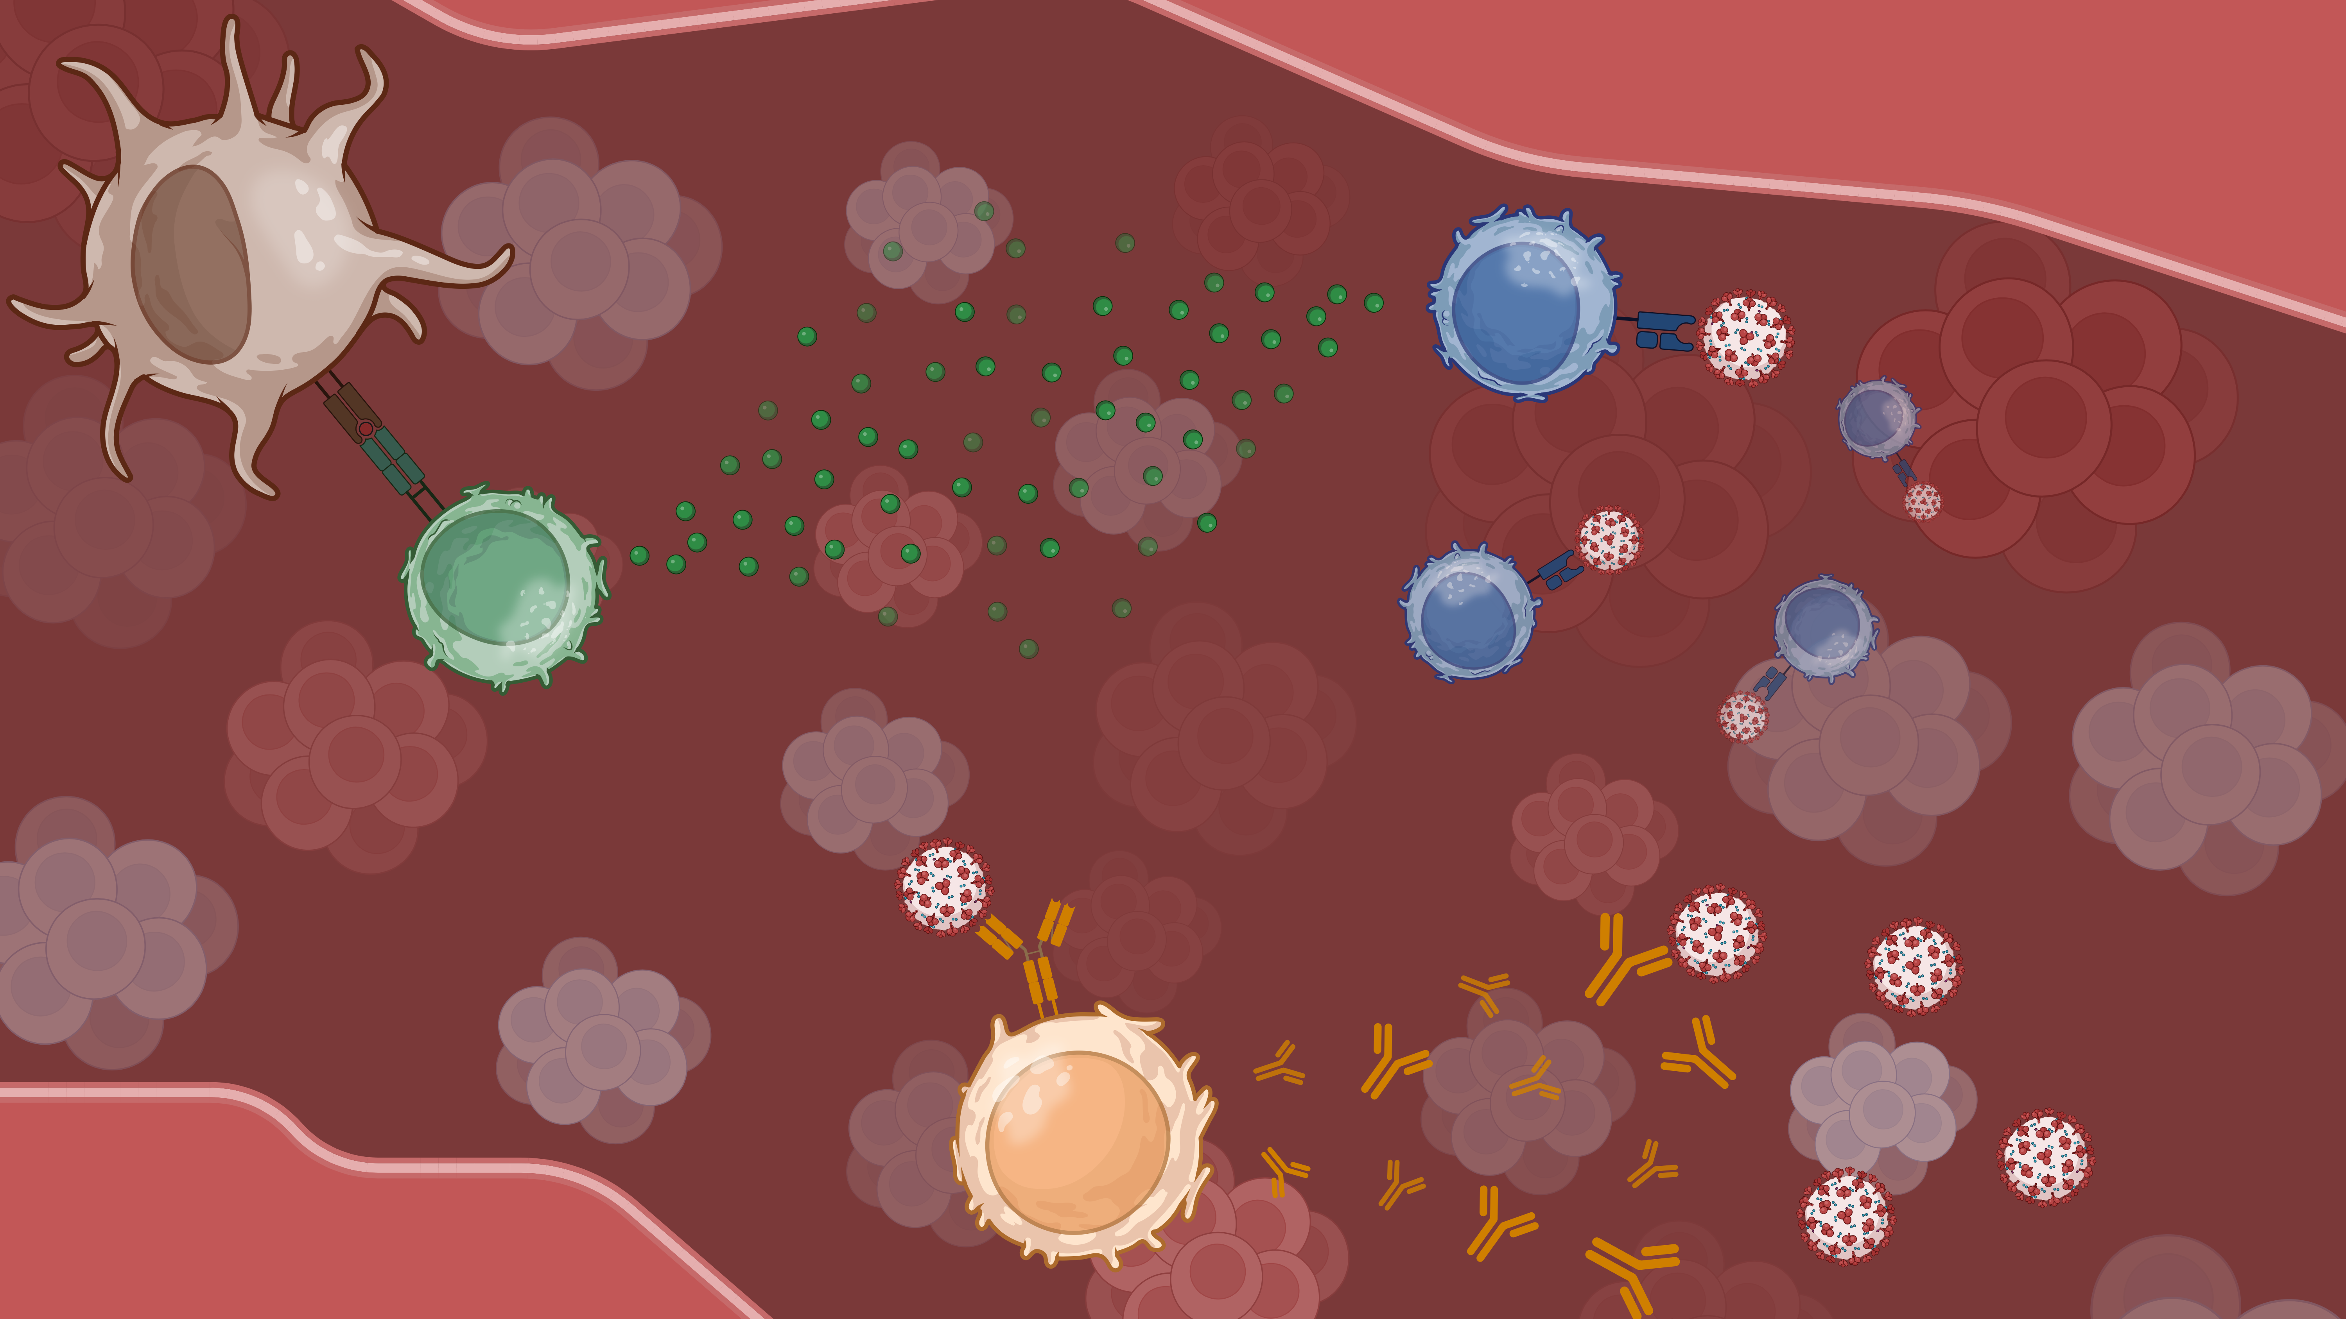
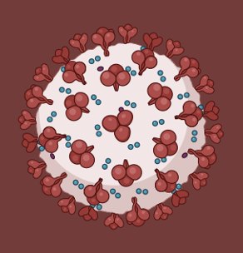

Slide 6
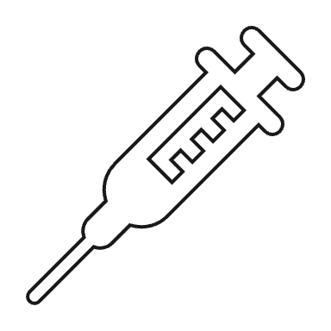
Study Design
0-3 Months
6-9 Months
12-15 Months
V0
V1
V2
V3
BV1
BV2
BV3
0-3 Months
6-9 Months
12-15 Months
Population | Demographics
89 Patients 12 Healthy Controls | 12 Diagnoses 10 Immunosuppressive Therapies 3 Vaccine Formulas

Slide 7
T Cell Methodology – ELISpots
ELISpot
Cells that secreted IFNy created a “spot” in the well plate
We investigated subjects by therapy at V1 then longitudinally
Qualitative T Cell Activation

Slide 8
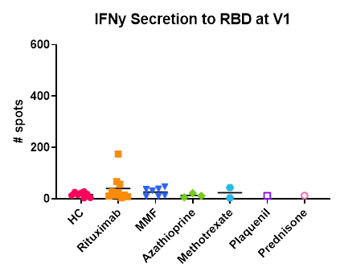
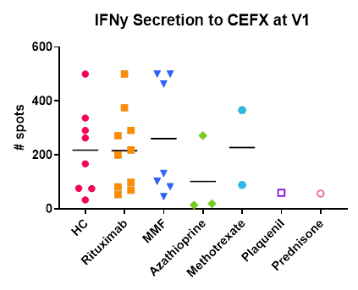
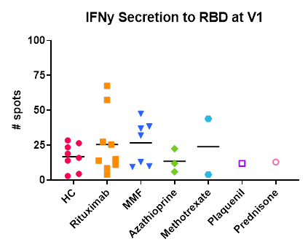
V1 T Cell Activation
Pt vs HC
Similar CEFX & RBD Responses Respectively
CEFX vs RBD
High CEFX (avg 200) vs Low RBD (avg 25)

Slide 9
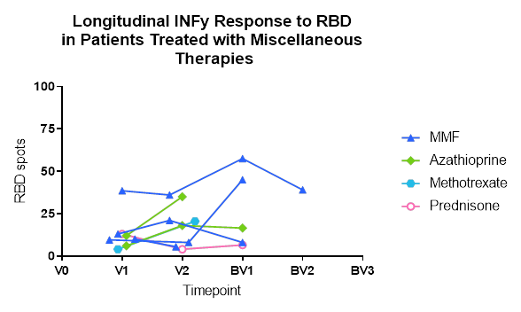
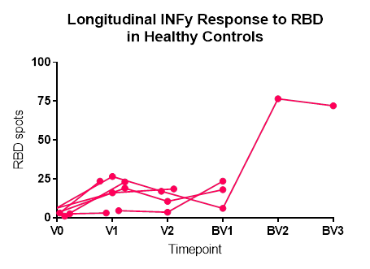
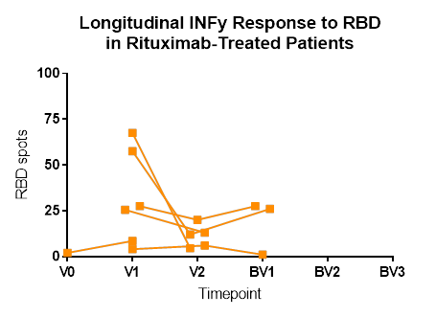
Longitudinal T Cell Activation
HC vs Rtx
Variance
Decrease V1-V2 and Increase V2-BV1
Variance Between HC vs Rtx

Slide 10
T Cell Methodology – Flow Cytometry
Flow Cytometry
Cytokines were combined and measured as percent of parent
We investigated 4 T cell subtypes by therapy at V1/V2 and BV2/BV3
Quantitative Cytokine Production

Slide 11
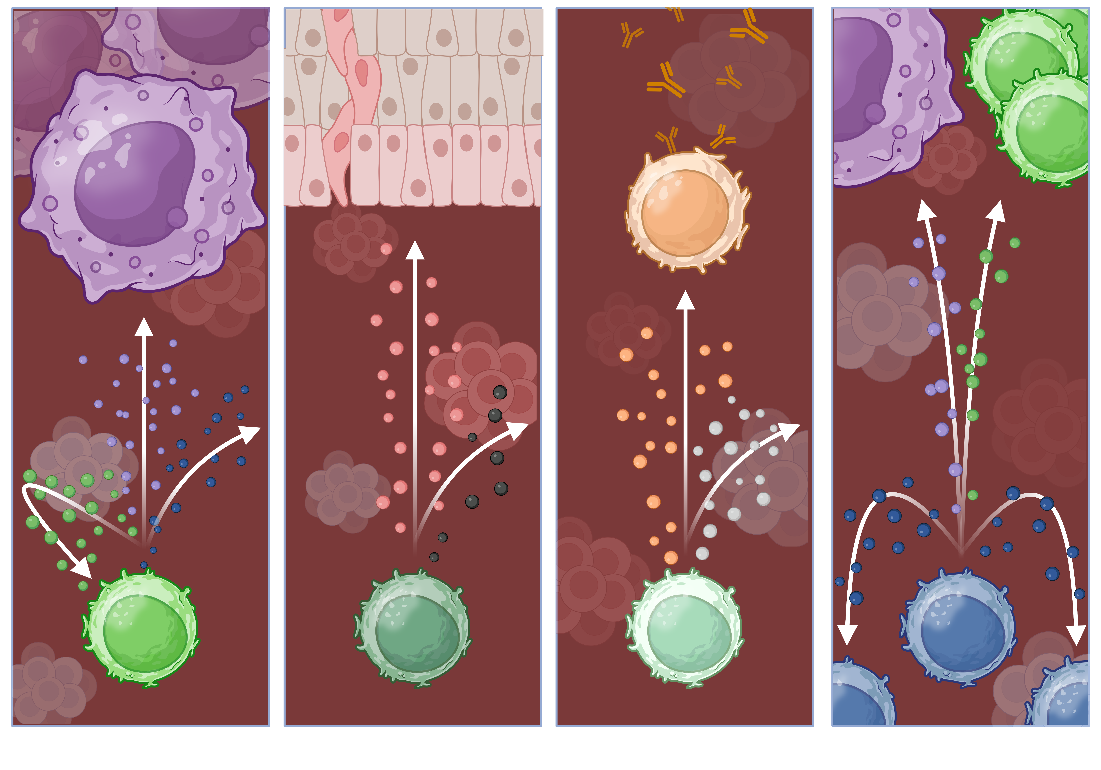
IL-2
IL-17FA & IL-17F
IFNy
IL-21
IFNy
IL-2
TNFa
IL-22
IL-10
TNFa
Th1
Th17
Tfh
CD8+

Slide 12
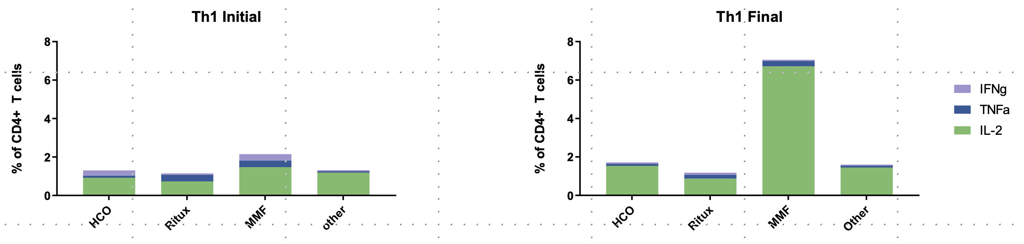
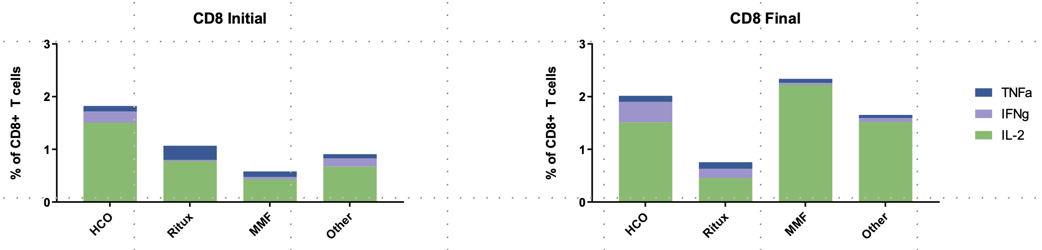
Effector T Cell Profiles
Robust Increase
Production Increases (Particularly IL-2)
Sacrifices
IFNy & TNFa Sacrificed for IL-2 Production

Slide 13
IL-2
IL-17FA & IL-17F
IFNy
IL-21
IFNy
IL-2
TNFa
IL-22
IL-10
TNFa
Th1
Th17
Tfh
CD8+

Slide 14
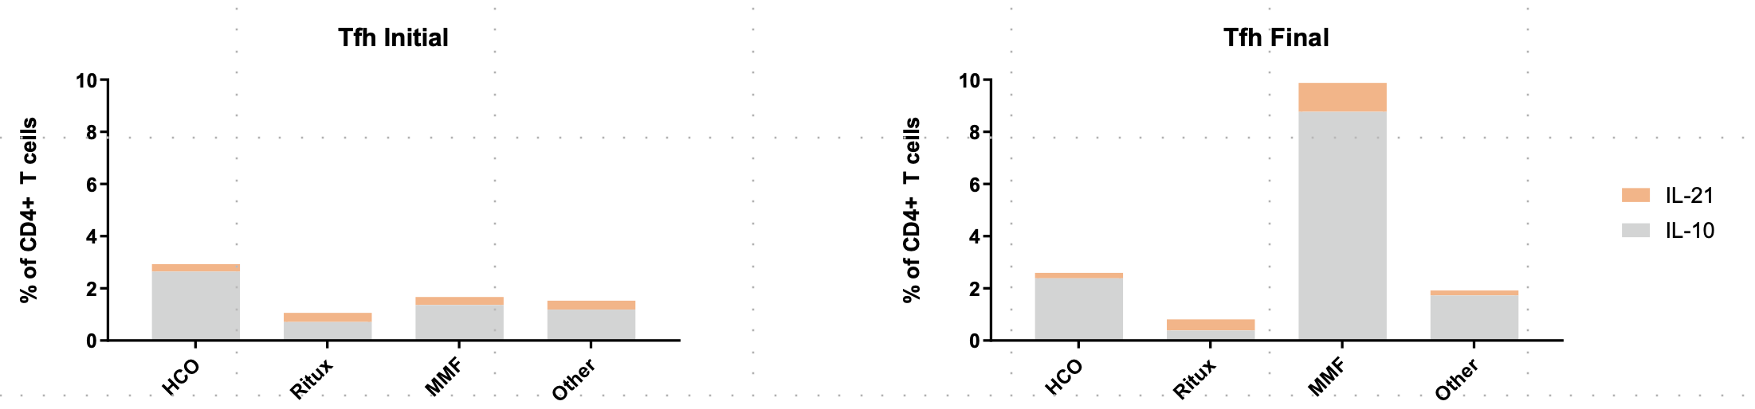
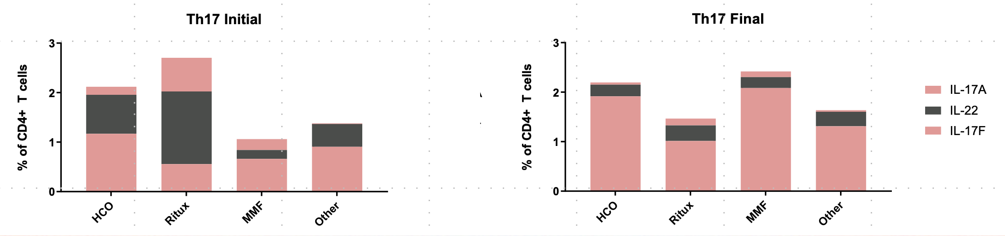
Inflammatory T Cell Profiles
Robust Increase
Production Increases (Particularly IL-10 & IL-17F)
Sacrifices
Cytokines Sacrificed for IL-10 & IL-17F Production

Slide 15
B Cell Methodology – Percent Inhibition
Percent Inhibition
Percent inhibition was calculated from antibody-RBD binding ability
Qualitative nAb Percent Inhibition
We investigated percent inhibition of all patients longitudinally

Slide 16
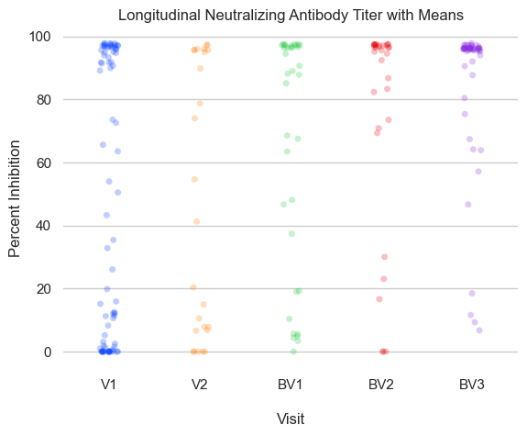
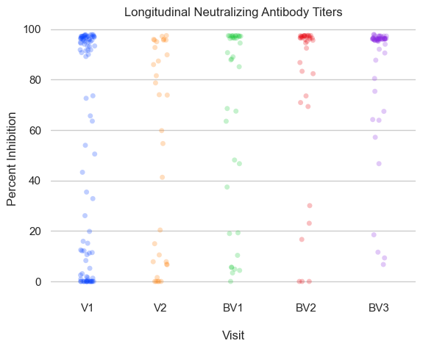
Longitudinal Percent Inhibition
V1 to V2
Cluster 3 – Adequate
Decrease as Seen in T Cell IFNy
Cluster 2 – Moderate
V2 to BV1
Increase as Seen in T Cell IFNy
Cluster 1 – Inadequate
BV1 Onward
Steady Rise Over Time

Slide 17
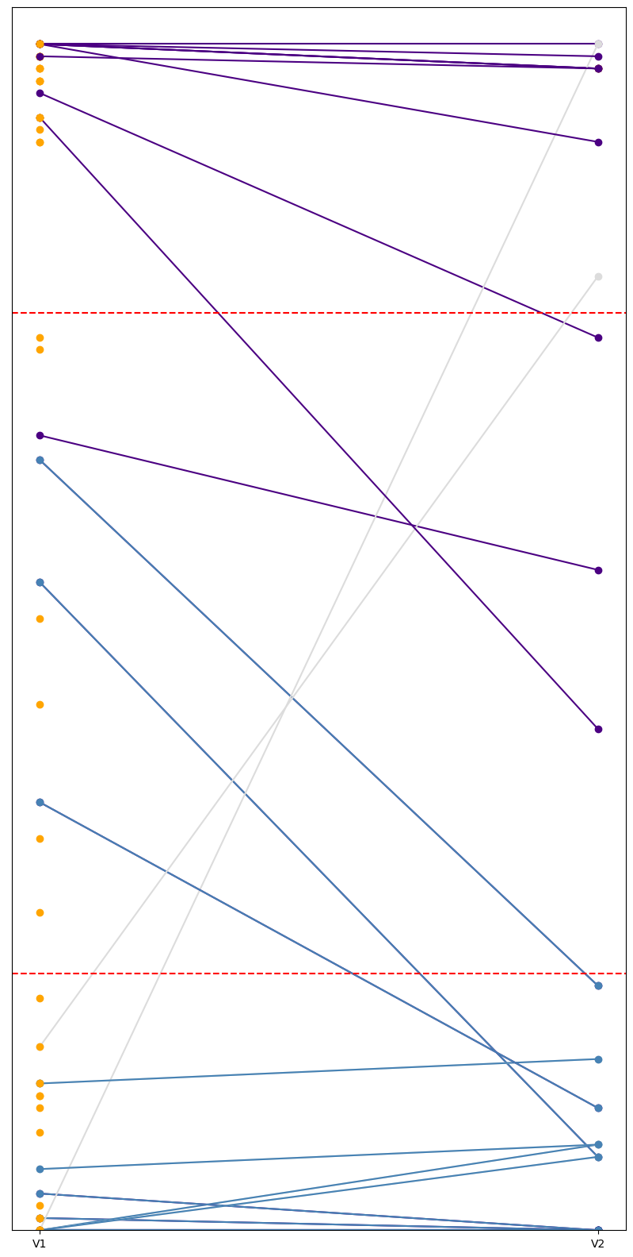
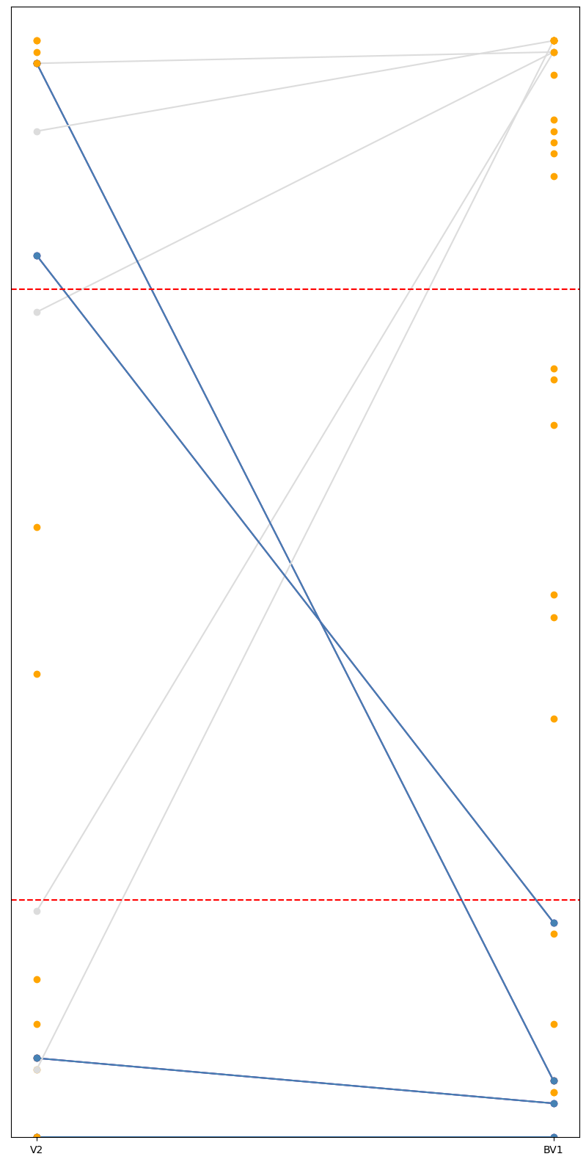
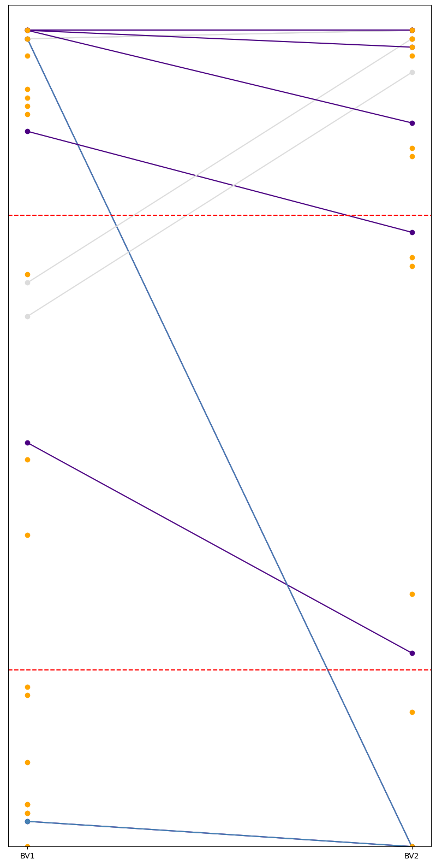
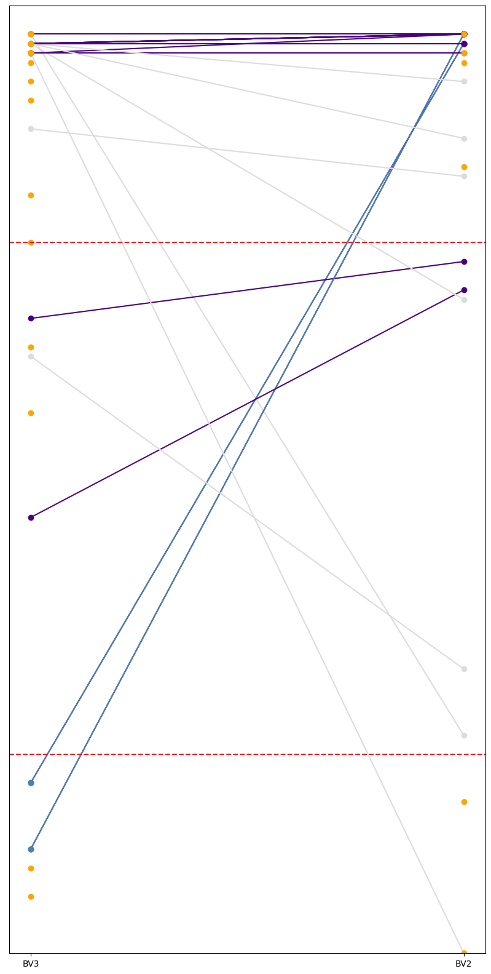
INCREASED PERCENT INHIBITION
DECREASED PERCENT INHIBITION
ENDED IN CLUSTER 1
DISCRETE SAMPLE
100
90
80
70
60
50
40
30
20
10
0
V1
V2
BV1
BV2
BV3

Slide 18
DISCUSION & ANALYSIS
Conclusive Findings From Our Investigations:
T Cell Immunity Against SARS-CoV-2 RBD Relatively Unaffected
Primary Demographics Irrelevant to Percent Inhibition
Percent Inhibition Dictated by Unknown Indicator – Potentially Therapy Administration
Key Takeaway: Immunosuppressed patients possess variable protection from vaccination which we cannot yet predict but strongly believe is relevant to therapy administration timeline

Slide 19
THANK YOU
Lauren Blazek, Donna Bunch, Dominic Ciavatta, Mary Mac Collie, Donna Culton, Vimal Derebail, Sandy Elmore, Ronald Falk, Meghan Free, Dorey Glenn, Candace Henderson, Carolina Herrera, Susan Hogan, Kristin Kennedy, Prem Lakshmanane, Andrew Le, Sarah Lewis, Nicole Orzechowski, Caroline Poulton, Manish Saha, Eveline Wu

